Slide 1

IMDB MOVIE ANALYSIS
TANMAY HARSH
FINAL PROJECT-1

Slide 2
PROJECT DESCRIPTION
In this project I analysed and drew useful insights out of the IMDB movies dataset consisting of various parameters.

Slide 3
approach
I used my basic MS-Excel knowledge to solve the tasks, which I learned from the course videos on MS-Excel provided by Trainity.
I used various inbuilt MS-Excel functions to get the desired results in accordance to the provided task questions.

Slide 4
Tech-stack used
MS-Excel
I chose MS-Excel because it is one of the oldest and most reliable software to store data in the form tables .

Slide 5
insights
I got a rough idea about how IMDB ratings affect the success and failure of a movie.
Also, I gained some knowledge about other factors that affect the movies listed on IMDB, in turn helping me brush up my MS-Excel knowledge.
The most important trend which I observed was the movies with higher runtime i.e movie duration tend to be more successful as they fall in the higher category w.r.t the IMDB ratings.

Slide 6
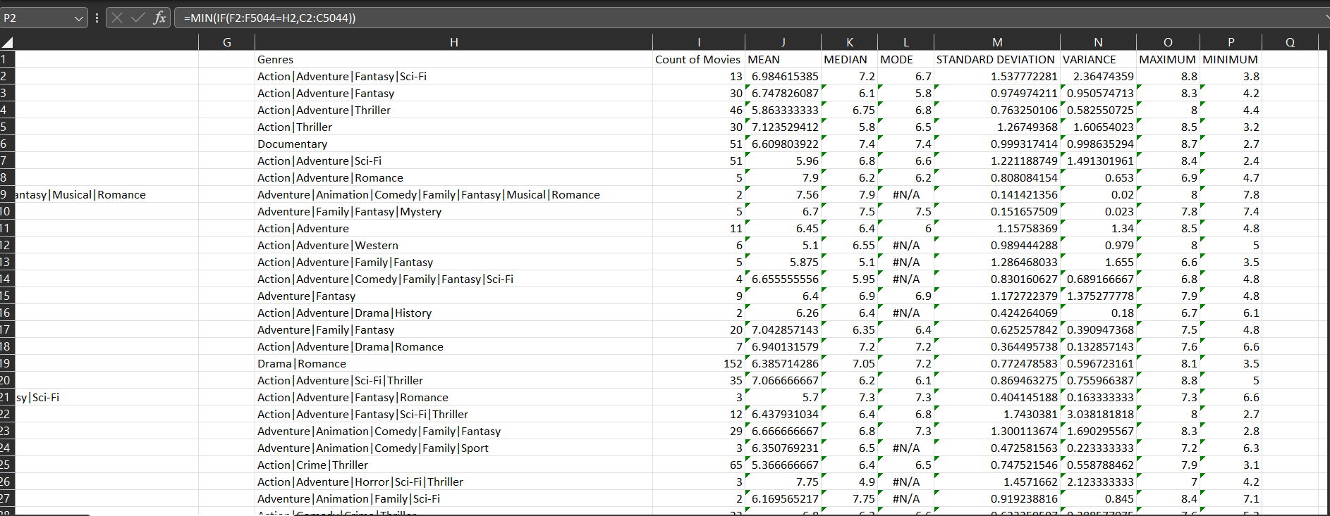
results
MOVIE GENRE ANALYSIS

Slide 7
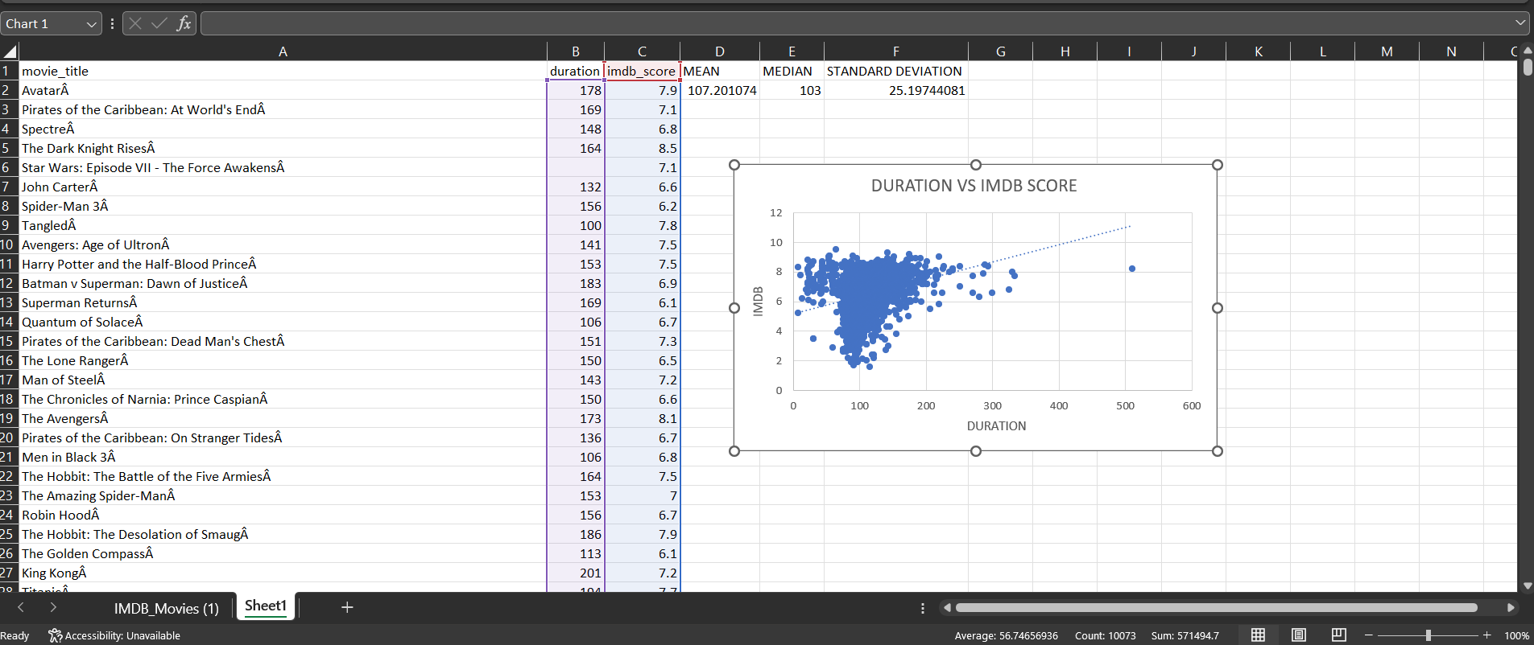
B. MOVIE DURATION ANALYSIS

Slide 8
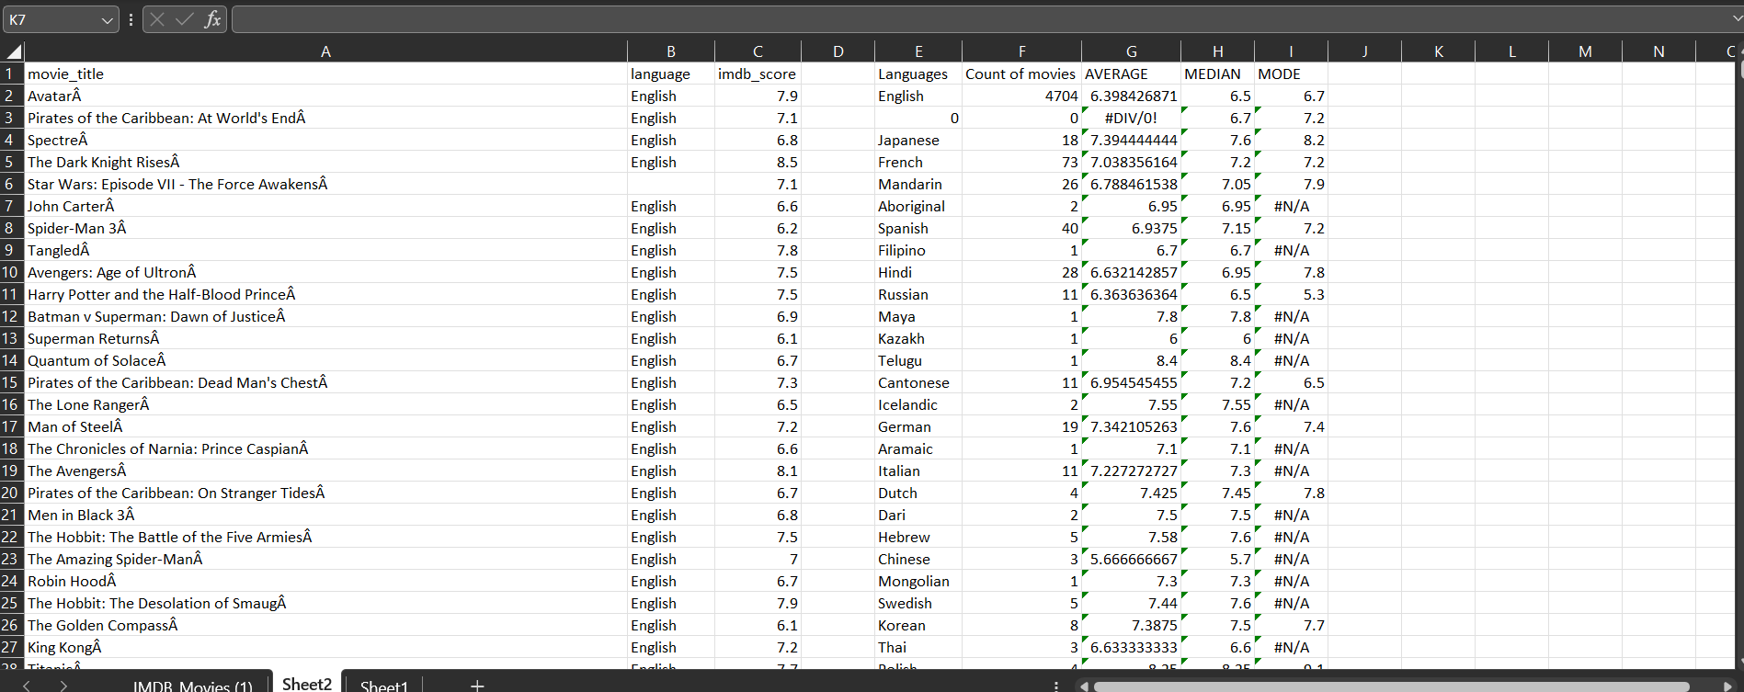
C. LANGUAGE ANALYSIS

Slide 9
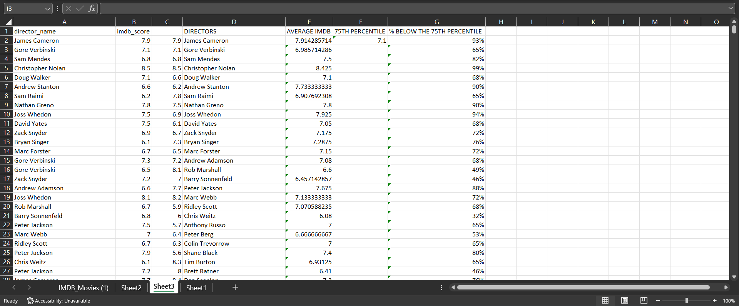
D. DIRECTOR ANALYSIS

Slide 10
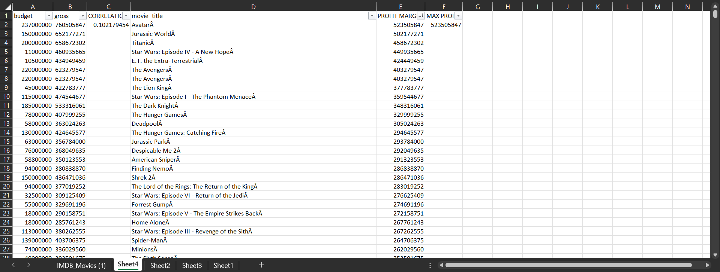
E. BUDGET ANALYSIS

Slide 11
I successfully solved all the tasks given to me and completed the Final Project-1.
The impact of genres on the IMDB ratings of movies was quite evident on analysing by using the statistical methods. Comedy|Family|Fantasy|Romance genre had the best IMDB ratings based on statistical values.
The impact of movie duration on IMDB values was also very clearly visible by presenting the comparison between the 2 by using scatterplot. The trendline clearly shows on increasing movie duration , the IMDB ratings improves.
Maximum movies were found to be versed in English language, but the statistical values of IMDB ratings of English movies were relatively lower than some of the other languages.
Christopher Nolan was the most successful director as 99% movie directors other than him had average IMDB ratings lower than his movies.(99% of 75th percentile)
Avatar movie came out to be the most profitable movie among 5044 movies listed in the dataset with the highest profit margin followed by Jurrasic Park and Titanic.
The above mentioned points were the major insights and conclusions that were deduced after analysing the dataset with the use of MS-Excel.

Slide 12
THANK YOU

